Slide 1
Market Update, 9/13
Quant Lab
Israel Diego

Slide 2
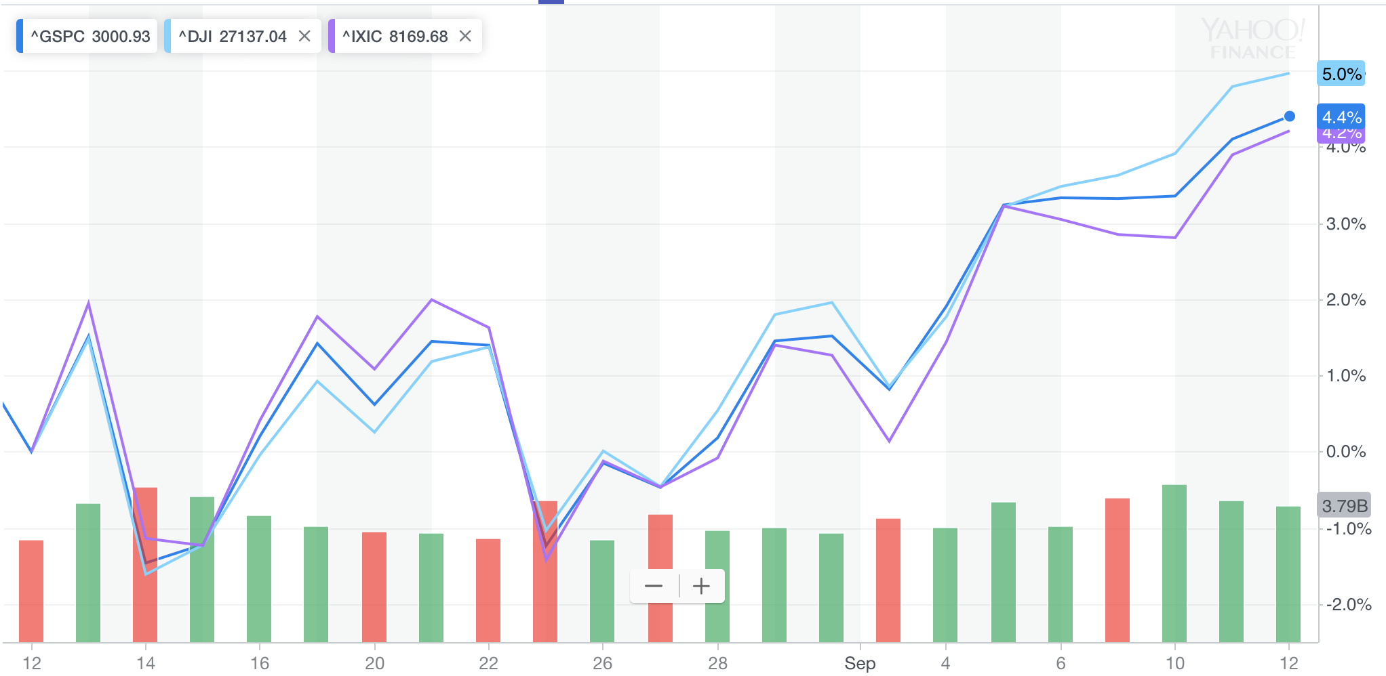
What happened this week?

Slide 3
Sept 3rd:
Wall street starts September on down note
Trump sets new tariffs $112 billion Chinese goods. China retaliated with $75 billion worth of U.S goods. Investors losing faith that deal will be reached by end of year.
Stocks decline; institute for supply management (ISM) index contracted for first time in 3 years to 49.1 due to tariffs and global slow down. DOW dropped 428 points at one point.
Industrials/Tech lead
Sept 4th:
Stocks rebound, extradition bill will be withdrawn. Dow, S&P 500, and Nasdaq close higher by nearly 1%
Energy sector performs the best as result of new U.S sanctions on Iran
Fed’s optimistic
Sept 5th:
China and U.S schedule trade talks for October
Stocks perform better as a response
Companies that sell their products in China performed better such as 3M and Caterpillar,
Sept 6th:
Stocks higher, gains due to hopes that there will be some kind of agreement with China. Tapestry led S&P 500, retailers remain robust despite trade war news. PVH 2nd best. Tyson lagged the most.

Slide 4
Sept 9th:
Stocks start the week strong. S&P 500 performed better due to easing tensions and weaker dollar. Caterpillar, Schlumberger, nvidia all had returns of about 6%
Sept 10th:
Headlines spark trade optimism. Top trade officials from China say they are ready to buy more U.S agricultural goods in exchange for a delay in tariffs and ease restrictions on Huawei. Crude oil falls as Trump fired John Bolton because of differing opinions on Iran and North Korea. Fears of attack on Iran have decreased. New iPad and iPhone 11.
Sept 11:
More trade optimism. S&P 3000 fueled by trade-sensitive and economically sensitive companies like boeing, apple, and united technologies.
Rotation: Bond yields went down: banks, transportation stocks, energy, retail, tend to do better when economy is improving. Defensive Stocks lag, Consumer staples, real estate, utility are down. Due to Trade Optimism.
Sept 12:
President Trump agreed to delay tariffs on China for 2 weeks. ECB would also provide more stimulus to stave off a severe downturn. Stocks are looking expensive at the moment.

Slide 5
News Links
Goldman Sachs Says U.S.-China Trade, Not Fed, Is Driving Dollar
Aussie Stimulus Flops, ECB Resumes QE, Mini Trade Deal: Eco Day
Trump Advisers Consider Interim China Deal to Delay Tariffs

